Slide 1
Tree Searching Strategies

Slide 2
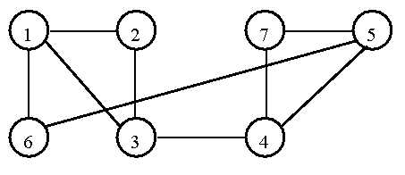
Hamiltonian Cycle Problem
A graph containing a Hamiltonian cycle.

Slide 3
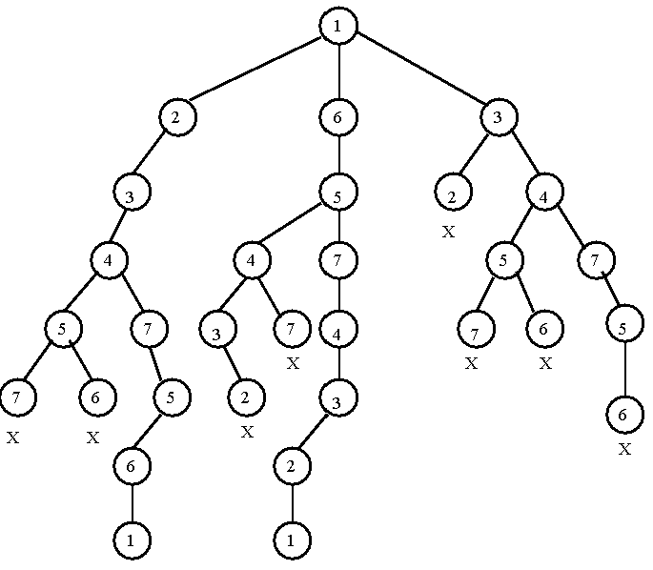
The tree representation of whether there exists a Hamiltonian cycle.

Slide 4
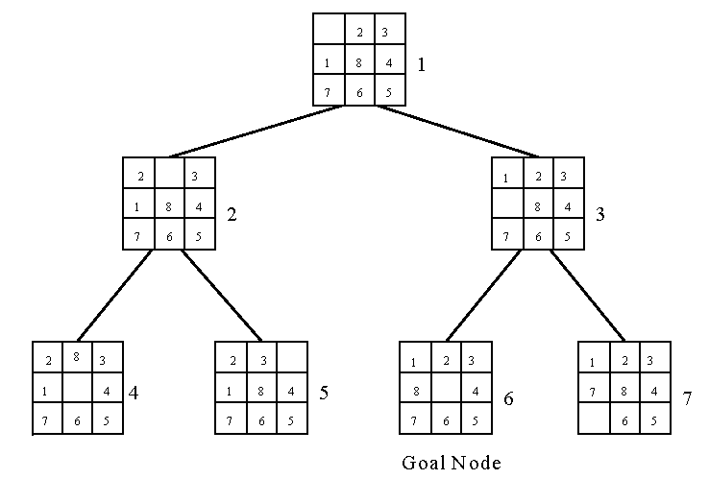
Breadth-First Search (BFS)
8-puzzle problem
The breadth-first search uses a queue to hold all expanded nodes.

Slide 5
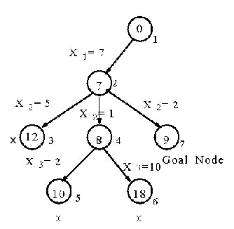
Depth-First Search (DFS)
e.g. sum of subset problem
S={7, 5, 1, 2, 10}
∃ S’ ⊆ S ∋ sum of S’ = 9?
A stack can be used to guide the depth-first search.
A sum of subset problem solved by depth-first search.

Slide 6
Hill Climbing
A variant of depth-first search
  The method selects the locally optimal node to expand.
e.g. 8-puzzle problem
evaluation function f(n) = d(n) + w(n),
where d(n) is the depth of node n
w(n) is # of misplaced tiles in node n.

Slide 7
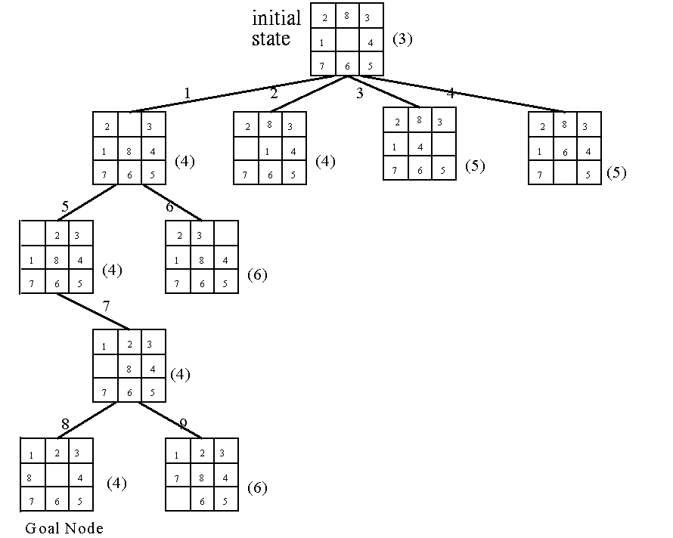
An 8-puzzle problem solved by a hill climbing method.

Slide 8
Best-First Search Strategy
Combine depth-first search and breadth-first search.
Select the node with the best estimated cost among all nodes.
This method has a global view.

Slide 9
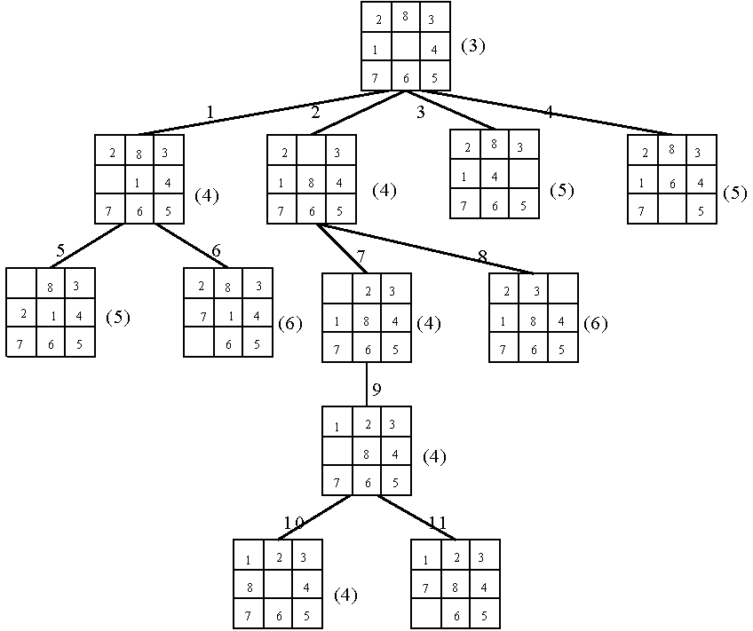
An 8-puzzle problem solved by a best-first search scheme.

Slide 10
Best-First Search Scheme
Step1: Form a one-element list consisting of the root node.
Step2: Remove the first element from the list. Expand the first element. If one of the descendants of the first element is a goal node, then stop; otherwise, add the descendants into the list.
Step3: Sort the entire list by the values of some estimation function.
Step4: If the list is empty, then failure. Otherwise, go to Step 2.

Slide 11
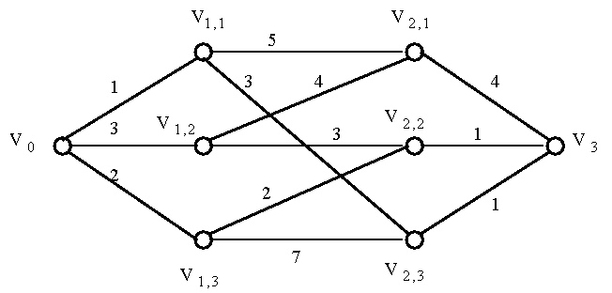
Branch-and-Bound Strategy
This strategy can be used to efficiently solve optimization problems.
e.g.
A multi-stage graph searching problem.

Slide 12
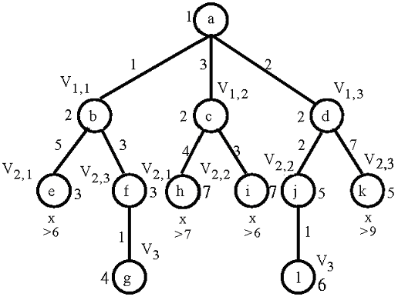
Solved by branch
-and-bound

Slide 13
Personnel Assignment Problem
A linearly ordered set of persons P={P₁, P₂, …, P_{n}} where P₁<P₂<…<P_{n}
A partially ordered set of jobs J={J₁, J₂, …, J_{n}}
Suppose that P_{i} and P_{j} are assigned to jobs f(P_{i}) and f(P_{j}) respectively. If f(P_{i}) ≤ f(P_{j}), then P_{i} ≤ P_{j}. Cost C_{ij} is the cost of assigning P_{i} to J_{j}. We want to find a feasible assignment with the minimum cost. i.e.
X_{ij} = 1 if P_{i} is assigned to J_{j}
X_{ij} = 0 otherwise.
Minimize ∑_{i,j} C_{ij}X_{ij}

Slide 14
e.g. A partial ordering of jobs
After topological sorting, one of the following topologically sorted sequences will be generated:
One of feasible assignments:
P₁→J₁, P₂→J₂, P₃→J₃, P₄→J₄
J₁
J₂
↓
↘
↓
J₃
J₄
J₁,
J₂,
J₃,
J₄
J₁,
J₂,
J₄,
J₃
J₁,
J₃,
J₂,
J₄
J₂,
J₁,
J₃,
J₄
J₂,
J₁,
J₄
J₃

Slide 15
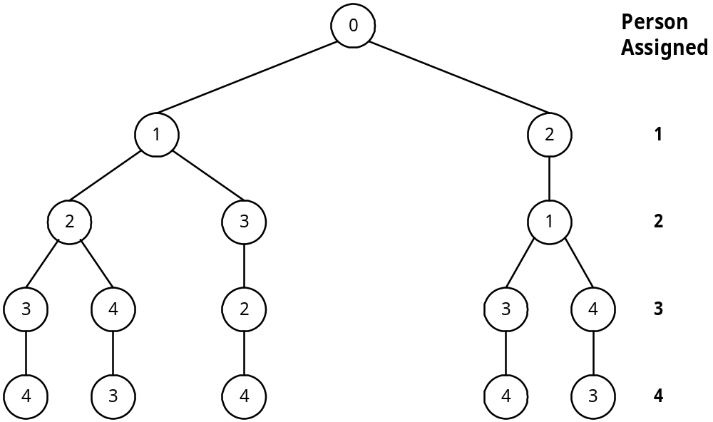
A Solution Tree
All possible solutions can be represented by a solution tree.
J₁
J₂
↓
↘
↓
J₃
J₄

Slide 16
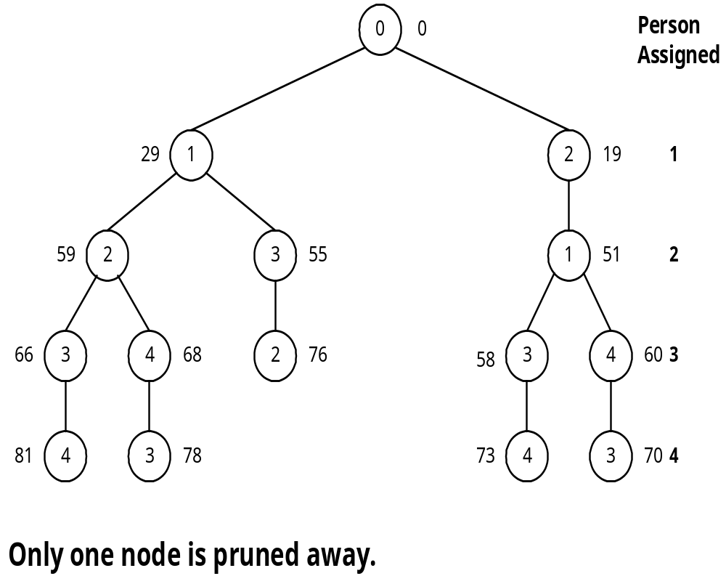
Cost Matrix
Apply the best-first search scheme:
Cost matrix
Jobs
Persons
1
2
3
4
1
29
19
17
12
2
32
30
26
28
3
3
21
7
9
4
18
13
10
15

Slide 17
Reduced Cost Matrix
Cost matrix
Reduced cost matrix
Jobs
Persons
1
2
3
4
Jobs
Persons
1
2
3
4
1
29
19
17
12
1
17
4
5
0
(-12)
2
6
1
0
2
(-26)
2
32
30
26
28
3
0
15
4
6
(-3)
3
3
21
7
9
4
8
0
0
5
(-10)
4
18
13
10
15
(-3)

Slide 18
A reduced cost matrix can be obtained:
subtract a constant from each row and each column respectively such that each row and each column contains at least one zero.
Total cost subtracted: 12+26+3+10+3 = 54
This is a lower bound of our solution.

Slide 19
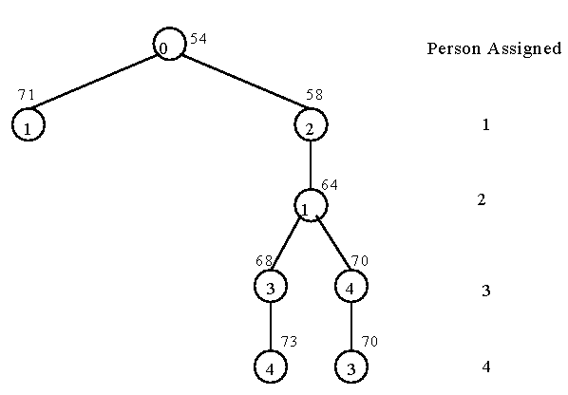
Branch-and-Bound for the Personnel Assignment Problem
Bounding of subsolutions:
Jobs
Persons
1
2
3
4
1
17
4
5
0
2
6
1
0
2
3
0
15
4
6
4
8
0
0
5

Slide 20
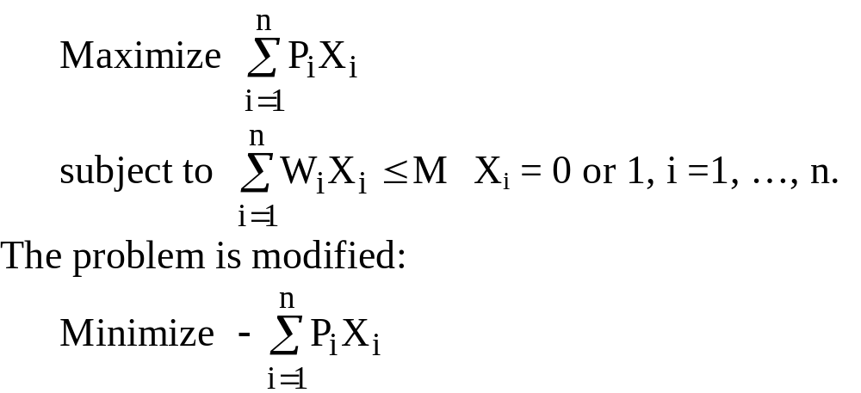
The 0/1 Knapsack Problem
Positive integers P₁, P₂, …, P_{n} (profit)
W₁, W₂, …, W_{n} (weight)
M (capacity)

Slide 21
e.g. n = 6, M = 34
A feasible solution: X₁ = 1, X₂ = 1, X₃ = 0, X₄ = 0, X₅ = 0, X₆ = 0
-(P₁+P₂) = -16 (upper bound)
Any solution higher than -16 cannot be an optimal solution.
i
1
2
3
4
5
6
P_{i}
6
10
4
5
6
4
W_{i}
10
19
8
10
12
8
(P_{i}/W_{i} ≥ P_{i+1}/W_{i+1})

Slide 22
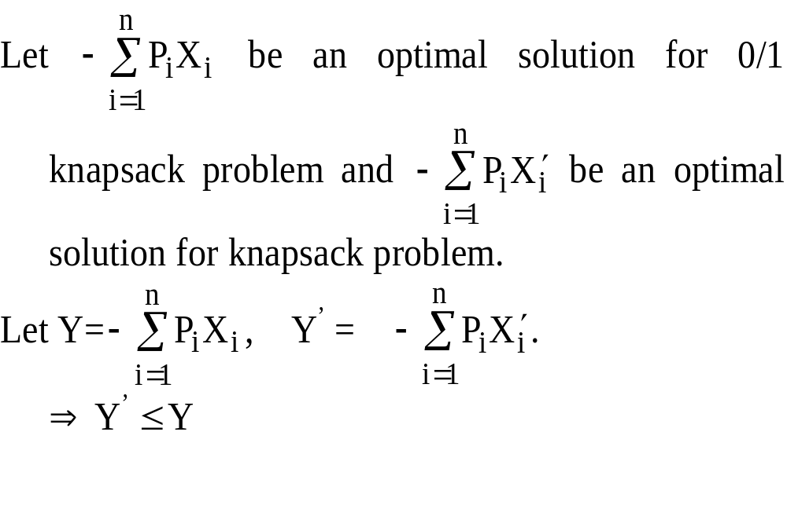
Relax the Restriction
Relax our restriction from X_{i} = 0 or 1 to 0 ≤ X_{i} ≤ 1 (knapsack problem)

Slide 23
Upper Bound and Lower Bound
We can use the greedy method to find an optimal solution for knapsack problem:
X₁ = 1, X₂ =1, X₃ = 5/8, X₄ = 0, X₅ = 0, X₆ =0
-(P₁+P₂+5/8P₃) = -18.5 (lower bound)
-18 is our lower bound (only consider integers)
⇒ -18 ≤ optimal solution ≤ -16
optimal solution: X₁ = 1, X₂ = 0, X₃ = 0, X₄ = 1, X₅ = 1, X₆ = 0
-(P₁+P₄+P₅) = -17

Slide 24
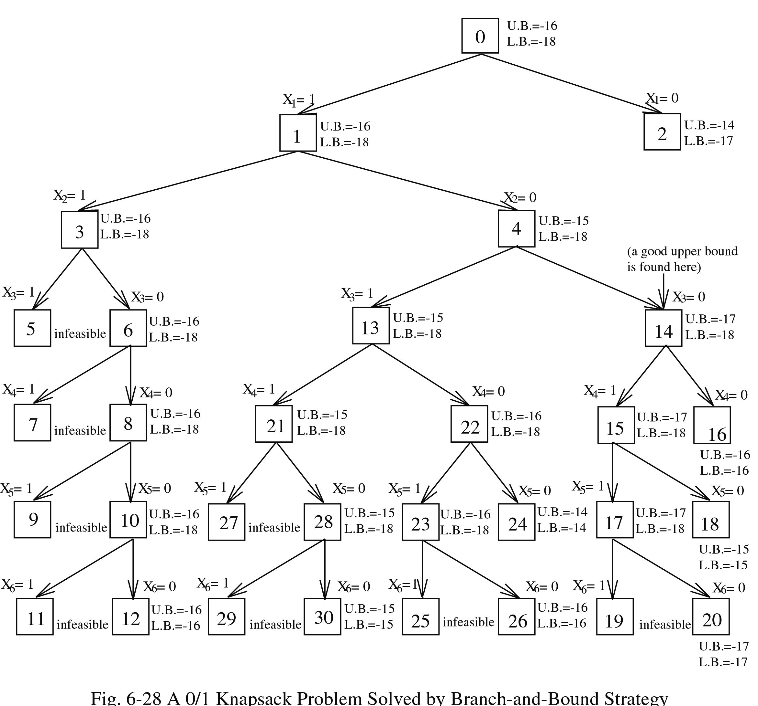
Expand the node with the best lower bound.
0/1 knapsack problem solved by branch-and-bound strategy.

